Slide 1
BDAT1005 – 23S Math for Data Analytics
Week 6 – starting Jun 12, 2023
Instructors: ss.1,2 – Ehsan Pourjavad; s.3 – Jonathan Gladstone; s.4 – Jonathan Wiersma

Slide 2

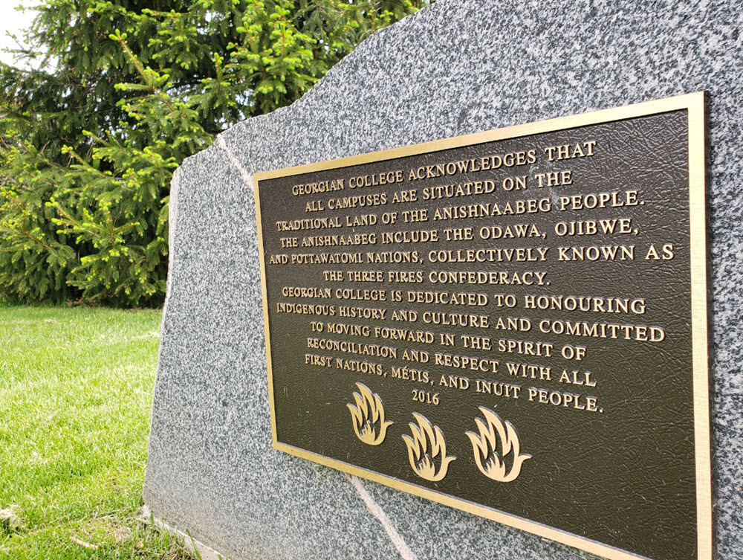
Georgian College acknowledges that all campuses are situated on the traditional land of the Anishnaabeg people. The Anishnaabeg include the Odawa, Ojibwe, and Pottawatomi nations, collectively known as the Three Fires Confederacy.
Georgian College is dedicated to honouring Indigenous history and culture and committed to moving forward in the spirit of reconciliation and respect with all First Nation, Métis and Inuit people.

Slide 3
Week 6 – Lesson 6: Hypothesis Testing 2 – ANOVA, MANOVA
Agenda¹
+0:00 to +0:20 Introduction; Mid-term exam preview (recording 1)
+0:20 to +1:00 L6a – ANOVA (recording 2)
+1:00 to +1:10 Break #1
+1:10 to +1:55 L6b – MANOVA (recording 3)
+1:55 to +2:05 Break #2
+2:05 to +2:25 Exercise 6ab – Hypothesis Testing in Excel, part 2² (recording 4)
+2:25 to +2:40 Evaluations & Assessments – Dataset Exploration part 3 (recording 5)
+2:40 to +2:50 Work Time / Office Hour³ (no recording)
Notes:
Recordings will be available after class; go to the General channel in the course Team and look under Files / Recordings / View Only. Note that recording numbers are as planned, not necessarily actual; the number of recordings and where they’re split may vary depending on circumstances during class. Recording names include the date and start time, as yyyymmdd_hhmmss (in Eastern time, of course, with the hours in 24-hour format).
MANOVA is not included with Excel’s basic functions or internal add-ins. We’ll download a free external add-in that includes this functionality, and more that we’ll use later in the term.
During this time, students may stay online to review material or work on assignments, or log off whenever they please. Your professor will be happy to publicly handle class or assignment questions or concerns. Individuals who have private concerns they want to discuss should make separate arrangements.

Slide 4
Week 6 Learning Objectives
Discuss the ANOVA technique and its use in statistical analysis. Explain when to use it, and (at a very high level) how results are calculated
Discuss the MANOVA technique and its use in statistical analysis. Explain when to use it, and (at a very high level) how results are calculated
Differentiate MANOVA from ANOVA, both in terms of its use and in terms of the ways they seek evidence for or against statistical significance
Use the Data Analysis Toolpak to run ANOVA in MS-Excel, including organizing data and interpreting the results
Use the Real Statistics Add-in to run MANOVA in MS-Excel, including organizing data and interpreting the results.

Slide 5
Course information
Watch out for speaker notes, shown with a superscript number like this¹
Use Blackboard for course information, weekly presentations, assignments, tests, discussion board etc; use MS-Teams for classes, instant messaging and collaboration (where permitted)
Submit all work in Blackboard; use MS-Office formats (Excel, Word etc)
To see feedback, go to ‘My Grades’; for DE detailed feedback, click on ‘View Rubric’.
When communicating with professors by e-mail or privately in Teams...²
Include your full name and student number – setting up a standard signature is an easy way to do this
Specify course and section – e.g. NETS1006 s1 – and, if applicable, assignment and group number in the subject line of the e-mail or body of the IM – and copy all members if it’s about a group effort
Attend every class!³ Please log in with numbered GC e-mail address⁴.
BDAT classes are all GCFlex this term⁵.
Studying for this course: use weekly PowerPoints, class recordings – and remember, quizzes & exams are closed book!⁶
Breaks – 10m after first hour – timings will vary⁷ – don’t be disruptive (phasers on stun, mics on mute, etc.)⁸
Technical issues? Try College IT Support, or Technical support for Computer Studies
Accommodations or other needs? Talk to Student Services
Notes:
Remember, you are responsible for understanding all course materials, including the explanations, clarifications, and citations/references in these speaker notes.
Many of your professors teach multiple sections of multiple courses and have a hundred or more students each term. If you don’t provide this information, we have to look it up each time we receive a student communication.
Or don’t – it’s up to you, and of course depends on your other commitments. Lesson materials are available before class time each week, and recordings are available afterward.
This makes it quicker & easier for us to separate you into breakout rooms for group activities and project work.
Some programs and/or courses may use other teaching modes, such as In-person, Hybrid, or Online.
Think of making a presentation at work, or running into a senior colleague in a meeting or around the office. If you can’t speak to these concepts without Googling them, what kind of data analyst will you be? It wouldn’t be very good for your career, that’s for sure!
When you’re participating online, you can generally take your own breaks whenever you need them (as long as you’re not presenting) – but we’ll have breaks anyway when your professor (and everyone else) can relax for a few minutes. If you’re watching recordings, that won’t matter either.
When you’re attending in person, don’t chatter, keep your phone and laptop silenced, and be as quiet as possible if you need to enter or leave the room during class. When you’re attending online, it’s up to you what and when to eat, chat with friends, listen to music or walk the dog… but none of us really wants to watch or listen to it! If you’re watching recordings afterward, this won’t matter.

Slide 6
Summary of assignments Week 5
Lessons 1-5, Exercises 1-5
Outstanding Evaluations & Assessments – ordered by due date
Lesson 3-4 Quiz – due end of day Sunday after week 5¹
Exercise 5 – OR, RR, χ², t-tests – complete before week 6²
Lesson 5 Quiz – due end of day Sunday after week 6³
Dataset Exploration part 2 – due end of day Sunday after week 7⁴
Update your work, perform univariate descriptives, check for outliers, clean, categorize & provide visualizations
Submission penalties – missing Turnitin report 5%; late submission 10% per week
Notes:
That’s Sun Jun 11, 23:59 Eastern Daylight Time (EDT=UTC-4h).
Complete it by Sun Jun 11, 23:59 EDT (UTC-4h). Exercises are not submitted or graded – you do them to assist you in learning the course material and building your skills.
That’s Sun Jun 18, 23:59 EDT (UTC-4h).
That’s Sun Jun 25, 23:59 EST (UTC-5h).

Slide 7
Mid-term exam
THIS IS A CLOSED-BOOK, INDIVIDUAL TEST. You may not collaborate in any way. You may not use any materials other than your mind, your keyboard and your pointing device, and you may not have any other applications (except a calculator) open on your computer
You should write your exam in a quiet place with a strong, stable internet signal; You should have your charger available, and your laptop software fully updated to reduce the chance of unexpected restarts
Please save your answers from time to time, watching to ensure that the process is working properly; if it's not, or if you have any other issue, please take screenshots of your progress and reconnect or restart as needed. You should be able to continue your exam, but any time spent will be lost.
The test is in Blackboard; it covers Lessons 1-5 and Exercises 2-5 and is worth 15% of the course; it will be open from start of day Tuesday to end of day Thursday in Week 7^{1,2} – you will each receive 50 questions (50 marks) to answer in 1.5 hours (90 min)
You get one try at the exam. Once your time is up, all answers will be automatically saved and the test will auto-submit
Notes:
That’s Tue Jun 20, 00:00, to Thu Jun 22, 23:59 Eastern Daylight Time (EDT=UTC-4h).
There will be no class in Week 7. If you want to meet with your professor, please reach out to arrange a mutually convenient time.

Slide 8
Mid-term exam
THIS IS A CLOSED-BOOK, INDIVIDUAL TEST. You may not collaborate in any way. You may not use any materials other than your mind, your keyboard and your pointing device, and you may not have any other applications (except a calculator) open on your computer
You should write your exam in a quiet place with a strong, stable internet signal; You should have your charger available, and your laptop software fully updated to reduce the chance of unexpected restarts
Please save your answers from time to time, watching to ensure that the process is working properly; if it's not, or if you have any other issue, please take screenshots of your progress and reconnect or restart as needed. You should be able to continue your exam, but any time spent will be lost.
Your mid-term exam is
one attempt in Week 7, open from start of day Tuesday until end of day Thursday.¹ There is no class in Week 7.²
Before you write… make sure your computer is up-to-date, your charger is connected, and you are in a quiet place with a strong, stable internet connection.
The test is in Blackboard; it covers Lessons 1-5 and Exercises 2-5 and is worth 15% of the course; it will be open from start of day Tuesday to end of day Thursday in Week 7^{1,2} – you will each receive 50 questions (50 marks) to answer in 1.5 hours (90 min)
You get one try at the exam. Once your time is up, all answers will be automatically saved and the test will auto-submit
Notes:
That’s Tue Jun 20, 00:00, to Thu Jun 22, 23:59 Eastern Daylight Time (EDT=UTC-4h).
There will be no class in Week 7. If you want to meet with your professor, please reach out to arrange a mutually convenient time.

Slide 9
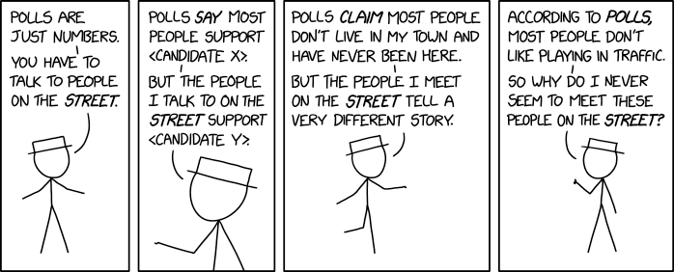
Before we start…
Next up: Lesson 6a
Always remember to check your facts!¹
Opinions are one thing; well-sourced analysis of appropriately collected data are another
“Other pollsters complain about declining response rates, but our poll showed that 96% of respondents would be 'somewhat likely' or 'very likely' to agree to answer a series of questions for a survey.”²
Notes:
The image is from xkcd, as usual: this one is https://xkcd.com/2357, originally published Sep 9, 2020. The alt-text is this: “Other pollsters complain about declining response rates, but our poll showed that 96% of respondents would be 'somewhat likely' or 'very likely' to agree to answer a series of questions for a survey.” Can you see the problem Randall Munroe is making light of here?

Slide 10
Lesson #6a – ANOVA
You have to understand your course information, but…
This is the part you have to study.¹
Remember, Lesson 6 is not covered in the Mid-term Exam!²
Notes:
You may also be assigned readings each week. We won’t cover everything from the readings and lesson slides and footnotes each week – but it’s up to you to learn from all of them. Exam questions will all be based on the lesson slides, speaker notes and assigned readings.
The Mid-term Exam covers only Lessons 1-5 (and Exercises 2-5)… but of course you already knew that.

Slide 11
What is ANOVA?
Analysis Of Variation – comparing the means of a given variable for multiple groups
Classic situation¹
One IV (independent variable; must be categorical²), one DV (dependent variable; must be quantitative) e.g. from a previous DE project, are IMDb movie ratings dependent on gender of lead actor?
Question: Does the quantitative variable depend on the categorical grouping?
Null Hypothesis: There is no statistically significant difference among the groups’ means
or
Notes:
ANOVA can handle more than one independent variable, but we’ll start off by imagining this simplest case.
If you want to use a qualitative variable as the IV, you must first categorize it.

Slide 12
The basic ANOVA situation
ANOVA allows for comparison of 3 or more groups
If the grouping (categorical) variable has only two values, just use a 2-sample T-Test!
An example:
Subjects: 25 patients with blisters
Treatments: Treatment A, Treatment B, Placebo
Measurement: # of days until blisters heal
Data values [counts, means]:
A: 5,6,6,7,7,8,9,10 [8, 7.250]
B: 7,7,8,9,9,10,10,11 [8, 8.875]
P: 7,9,9,10,10,10,11,12,13 [9, 10.11]
Are these differences significant?

Slide 13
Investigating the ANOVA Question
We can perform an informal graphical investigation
side-by-side box plots
multiple histograms
But we want real values, and likelihoods that they are right
Whether the differences between the groups are significant depends on
the difference in the means
the standard deviations of each group
the sample sizes
ANOVA determines P-value from F-statistic

Slide 14
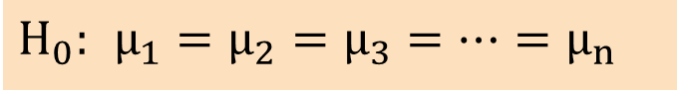
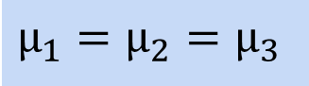
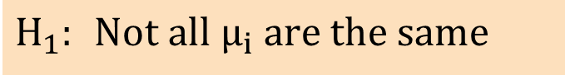
One-Factor ANOVA
All Means are the same:
The Null Hypothesis is True
(no difference among means²)
The ‘null hypothesis’ is that all means are the same¹...
... and the alternative is anything else
$$H_{0}: μ_{1}=μ_{2}=μ_{3}=⋯=μ_{n}$$
$$H_{1}: \text{Not} \text{all} {\text{μ}}_{i} \text{are} \text{the} \text{same}$$
$$μ_{1}=μ_{2}=μ_{3}$$
Notes:
The means don’t need to be exactly the same for us to accept the null hypothesis. But to reject it, at least one of the differences among the means must be statistically significant.
Some examples:
In a medical study, no difference is found in recovery time among groups receiving three different treatments.
In a computer performance analysis, no difference is found in CPU utilization for three different types of coding.

Slide 15
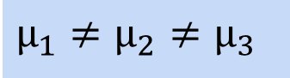
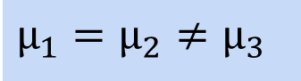
One-Factor ANOVA
At least one mean is different:
The Null Hypothesis is NOT true
(no difference among means²)
The ‘null hypothesis’ is that all means are the same¹...
... and the alternative is anything else
We usually refer to the ‘means of the groups’³
$$H_{0}: μ_{1}=μ_{2}=μ_{3}=⋯=μ_{n}$$
$$μ_{1}=μ_{2}≠μ_{3}$$
$$H_{1}: \text{Not} \text{all} {\text{μ}}_{i} \text{are} \text{the} \text{same}$$
or
$$μ_{1}≠μ_{2}≠μ_{3}$$
Notes:
The means don’t need to be exactly the same for us to accept the null hypothesis. But to reject it, at least one of the differences among the means must be statistically significant.
Some examples:
In a medical study, no difference is found in recovery time among groups receiving three different treatments.
In a computer performance analysis, no difference is found in CPU utilization for three different types of coding.
In ANOVA, the ‘groups’ are the sub-populations we want to compare.

Slide 16
Assumptions of ANOVA
Interpretation of ANOVA results must always be taken in the context of the research design – fancy statistical methods do not make up for poor design¹
Each group’s distribution is approximately normal
Can handle some non-normality, but not severe outliers
Check this by looking at histograms and/or normal quantile plots², calculate skewness/kurtosis, or make assumptions³
Standard deviations of each group are approximately equal (‘homogeneity of variances’)
Rule of thumb: The ratio of greatest group SD to the least group SD must be less than 2:1
In our previous example… Data values [count, mean, median, adding SD]:
A: 5,6,6,7,7,8,9,10 [8, 7.250, 7.000, 1.669]
B: 7,7,8,9,9,10,10,11 [8, 8.875, 9.000, 1.458]
P: 7,9,9,10,10,10,11,12,13 [9, 10.11, 10.000, 1.764]
We’ll assume the group distributions are normal. Since the greatest group SD is less than two times the value of the least (1.764 < 2 x 1.458), we can assume ANOVA will work correctly
Notes:
For example, the use of independent variables (IVs) can change the interpretation of other IVs, so choice of IVs to include needs to be thought about carefully.
We can also look at the skewness and kurtosis, of course – the usual rule will apply: is the absolute value of each less than 2?
With very small data sets, there really isn’t a really good way to check normality from data. But physical measurements of related phenomena (e.g. people’s healing time, or the prices of similar goods or services, or the fuel consumptions of similar vehicles) tend to be normally distributed, so we can make that assumption.

Slide 17
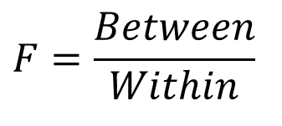
How ANOVA works: the F-statistic
ANOVA measures two sources of variation in the data and compares their relative sizes
Variation BETWEEN groups
For each data value, look at the difference between its group mean and the overall mean
Variation WITHIN groups
For each data value, look at the difference between that value and the mean of its group
The F-statistic is a ratio of Between Group Variation to Within Group Variation
A large value of F is evidence against H₀, because it indicates that there is more difference between groups than within groups – i.e. that there is a “difference that makes a difference”¹
$$F=\frac{Between}{Within}$$
Notes:
With apologies to Gregory F. Bateson, who wrote, “What we mean by information - the elementary unit of information - is a difference which makes a difference…” – Bateson, Gregory F., Steps to an Ecology of Mind, Chandler Publishing, USA, 1972; p.318, in Part III, Form and Pathology in Relationship, in an essay entitled “The Cybernetics of Self: A Theory of Alcoholism”.

Slide 18
Partitioning Variation
How do we split variation?
SST = Total Sum of Squares (total variation)
The aggregate dispersion of the individual data values across the various groups (factor levels)
We don’t need to calculate SST to find an F-statistic!
SSB = Sum of Squares Between Groups (between-group variation)
The dispersion between the group (factor) sample means
Also called SSA (Sum of Squares Among Groups), SSR (Regression Sum of Squares), Sum of Squares Explained, and Among Groups Variation
SSW = Sum of Squares Within Groups (within-group variation)
The dispersion among the individual data values within a particular group (factor)
Also called Sum of Squares Error, Sum of Squares Unexplained, and Within Groups Variation
SST = SSB + SSW

Slide 19
Partitioning Variation
Total Variation (SST)
=
Variation Due to Factor/Group (SSA)
+
Variation Due to Random Sampling (SSW)
Commonly referred to as:
Sum of Squares Between
Sum of Squares Among
Sum of Squares Explained
Among Groups Variation
Commonly referred to as:
Sum of Squares Within
Sum of Squares Error
Sum of Squares Unexplained
Within Groups Variation

Slide 20
Variation – Total
Response, X
Group 1
Group 2
Group 3

Slide 21
Variation – Between (Among) Groups
Response, X
Group 1
Group 2
Group 3

Slide 22
Variation – Within Groups
Response, X
Group 1
Group 2
Group 3

Slide 23
Interpreting the F-statistic in One-Factor ANOVA¹
The F-statistic is the ratio of the ‘among’ estimate of variance and the ‘within’ estimate of variance
The ratio must always be positive
“Go BIG or go HOME” – if your calculated F-statistic is not greater than F_{U} for your degrees of freedom and the desired significance level (degree of certainty)¹
Decision Rule
Reject H₀ if F > F_{U} for desired α, that is, if p_{F} < α
Accept H₀ if F ≤ F_{U} for desired α, that is, if p_{F} ≥ α
α ≤ 0.05 ^{see 2}
0
Accept H₀
Reject H₀
F_{U}
Notes:
It is possible to perform ANOVA with more than one ‘factor’, or independent categorical variable (IV). MS-Excel can handle one-factor or two-factor ANOVA, but not more.
F_{U} isn’t what it sounds like! It’s the expected value of the F-statistic for given degrees of freedom among and within groups, for a given Confidence Level.
No, that’s not 0.05 squared! If α ≤ 0.05, then we reject H₀ saying it could happen by chance only 1 in 20 times at most, and 1/20 = 0.05.

Slide 24
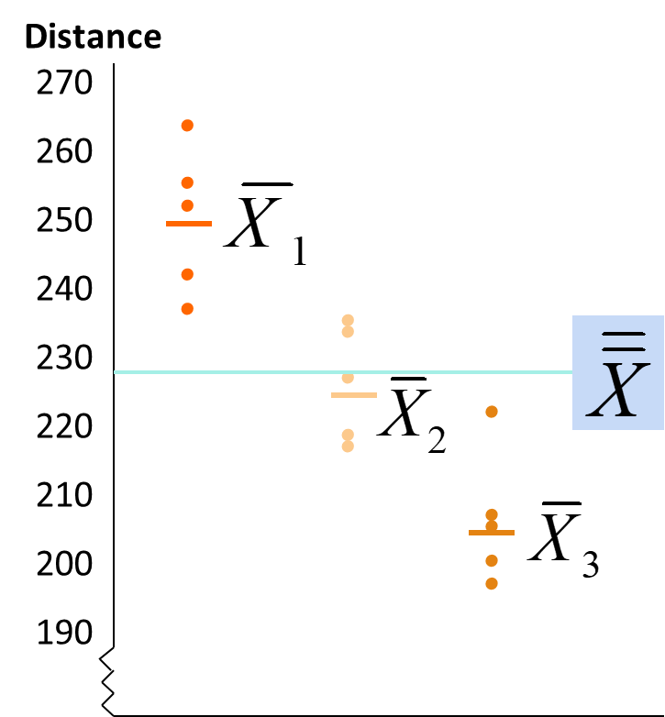
One-Factor ANOVA F-Test Example
We want to see if three different golf clubs yield different distances
Randomly select five measurements from trials on an automated driving machine for each club
At the .05 significance level, is there a difference in mean distance?
Club 1 Club 2 Club 3 254 234 200 263 218 222 241 235 197 237 227 206 251 216 204
First let’s find the means
After we find the means,
We can make a scatter diagram
We don’t really need it, but it helps us visualize the data, and also the technique

Slide 25
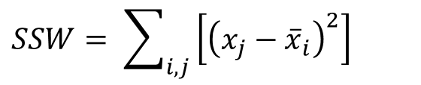
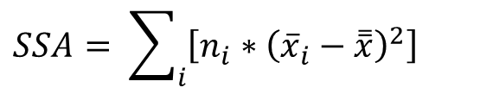
One-Factor ANOVA F-Test Example
Now let’s calculate the F-statistic
Randomly select five measurements from trials on an automated driving machine for each club
At the .05 significance level, is there a difference in mean distance?
We have the means; the counts are n₁=n₂=n₃=5, and n_{Total}=15
The number of groups is g=3
Club 1 Club 2 Club 3 254 234 200 263 218 222 241 235 197 237 227 206 251 216 204
$$SSA= \sum_{i}{\left[n_{i}∗{\left({\overline{x}}_{i}−\overset{̿}{x}\right)}^{2}\right] }$$
$$SSW= \sum_{i,j}{\left[{\left(x_{j}−{\overline{x}}_{i}\right)}^{2}\right] }$$

Slide 26
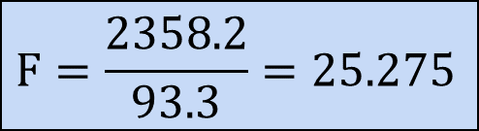
One-Factor ANOVA F-Test Example
Now let’s calculate the F-statistic
Randomly select five measurements from trials on an automated driving machine for each club
At the .05 significance level, is there a difference in mean distance?
We have the means; the counts are n₁=n₂=n₃=5, and n_{Total}=15
The number of groups is g=3
Club 1 Club 2 Club 3 254 234 200 263 218 222 241 235 197 237 227 206 251 216 204
SSA = 5*(249.2 – 227)² + 5*(226 – 227)² + 5*(205.8 – 227)² = 4716.4
SSW = (254 – 249.2)² + (263 – 249.2)² +…+ (204 – 205.8)² = 1119.6
MSA = 4716.4 / (3-1) = 2358.2
$$F=\frac{\text{2358.2}}{\text{93.3}}=\text{25.275}$$
MSW = 1119.6 / (15-3) = 93.3

Slide 27
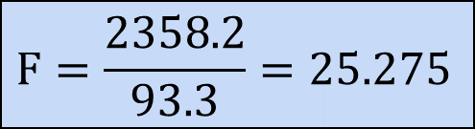
One-Factor ANOVA F-Test Example
Finally, let’s see if your F-statistic causes us to reject the null hypothesis
Randomly select five measurements from trials on an automated driving machine for each club
At the .05 significance level, is there a difference in mean distance?
Our degrees of freedom are df₁ = (3-1) = 2 & df₂ = (15-3) = 12
From a critical values table for p=0.05, we find F_{U}(2,12) = 3.89¹
Club 1 Club 2 Club 3 254 234 200 263 218 222 241 235 197 237 227 206 251 216 204
Reject H₀ at α = 0.05
α = .05
There is evidence that at least one μ_{i} differs from the rest!
0
$$F=\frac{\text{2358.2}}{\text{93.3}}=\text{25.275}$$
Do not
reject H₀
Reject H₀
F = 25.275
F_{U} = 3.89
Notes:
For an example of critical value tables for p=0.05 (as used here) and p=0.01, see http://users.sussex.ac.uk/~grahamh/RM1web/F-ratio%20table%202005.pdf

Slide 28
Excel ANOVA Output
# of groups minus 1
# of data values minus # of groups
(equals df for each group added together)
# of individuals minus 1
(just like other situations)

Slide 29
Computing ANOVA F-statistics in Excel¹
Notes:
We’ll show you how to do this more easily with the Analysis Toolpak, but this example shows that it is, under the covers, a pretty straightforward kind of calculation.

Slide 30
How big is F?
Since F is ‘Mean Square Between / Mean Square Within’ = MSG / MSE, a greater value of F indicates relatively more difference between groups than within groups – that’s evidence against the null hypothesis, H₀
But we need to know how confident we can be that a given value of F represents a significant difference among the groups’ means – we need a P-value!
To get the P-value, we compare to F(I-1,n-I)-distribution
I-1 degrees of freedom in numerator (# groups minus 1)
n-I degrees of freedom in denominator (rest of df; # of observations minus groups minus 1)
The greater the P-value, the more likely the result is to have been due to chance – for a typical 95% CL, we accept the null hypothesis if P>0.05

Slide 31
Where’s the Difference?
Once ANOVA indicates that the groups do not all appear to have the same means, what do we do?
Back to our original example of treatments for blisters…
Clearest difference: P is worse than A (CI’s don’t overlap)
Analysis of Variance for days
Source DF SS MS F P
treatmen 2 34.74 17.37 6.45 0.006
Error 22 59.26 2.69
Total 24 94.00
Individual 95% CIs For Mean
Based on Pooled StDev
Level N Mean StDev ----------+---------+---------+------
A 8 7.250 1.669 (-------*-------)
B 8 8.875 1.458 (-------*-------)
P 9 10.111 1.764 (------*-------)
----------+---------+---------+------
Pooled StDev = 1.641 7.5 9.0 10.5

Slide 32
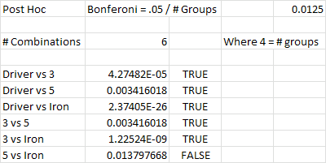
Multiple Comparisons
Once ANOVA indicates that the groups do not all have the same means, we can compare them two by two using the 2-sample t test, but we need to adjust our p-value threshold because we are doing multiple tests with the same data
There are several methods for doing this¹… one method is the Bonferroni correction
‘Combinations’ is the number of possible pairs we could compare
Quick Calculation for # combinations = n*(n-1)/2
Where n is the number of groups…
... in this case, four (Driver, 3 Wood, 5 wood, Iron)
So 4(4-2)/2 = 4*3/2 = 12/2 = 6
We can see that the 5 and the Iron are not different.
Notes:
If we really just want to test the difference between one pair of groups, we should set up our study that way. But of course that only helps if we’re doing primary research, not if we’re using secondary data.

Slide 33

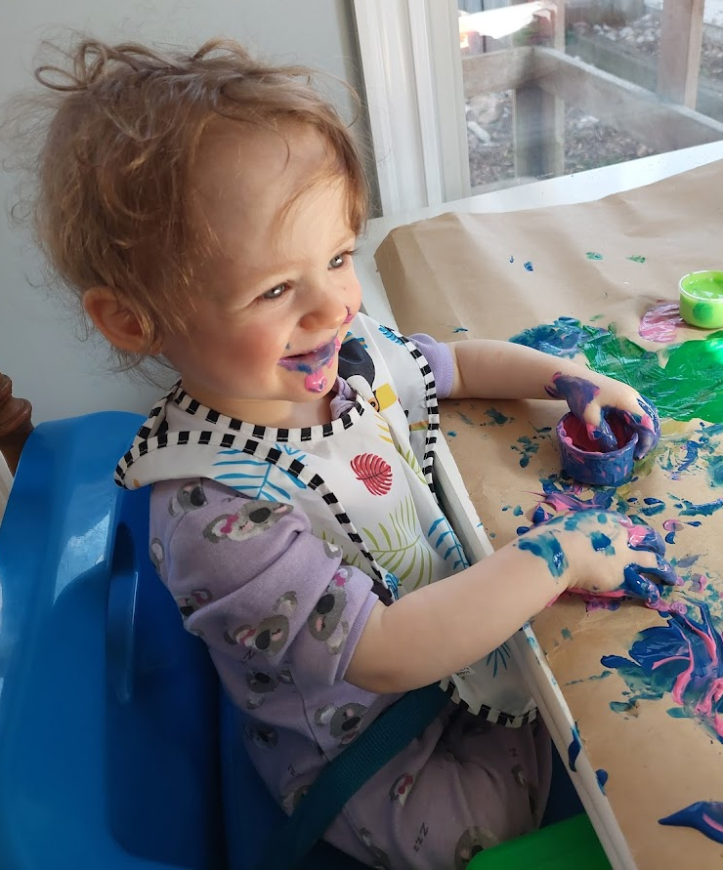
Next up: Lesson L6b
Placebo is my favourite flavour!¹
We’re not done yet…
Be back in your seats, phasers on stun and ready to go in ~10m
Notes:
Photo is of Prof. Gladstone’s grand-daughter in 2022, having her first taste (quite literally) of finger-painting.

Slide 34
Lesson #6b – MANOVA
You have to understand your course information, but…
This is the part you have to study.¹
Remember, Lesson 6 is not covered in the Mid-term Exam!²
Notes:
You may also be assigned readings each week. We won’t cover everything from the readings and lesson slides and footnotes each week – but it’s up to you to learn from all of them. Exam questions will all be based on the lesson slides, speaker notes and assigned readings.
The Mid-term Exam covers only Lessons 1-5 (and Exercises 2-5)… but of course you already knew that.

Slide 35
What is MANOVA?
Multivariate Analysis Of Variation – comparing the means of multiple numerical outcome variables for multiple groups in one or more categorical independent variables
MANOVA extends ANOVA so we can examine or assess the effects and interactions of one or more independent variables (IVs) on a combination of two or more Dependent Variables (DVs)¹
We test whether mean differences between IV groups on a combination of DVs is likely to occur by chance (null hypothesis)
In ANOVA we used calculated F-statistics from the variances by group in the outcome variable (the DV) to determine whether to reject the null hypothesis – in MANOVA we use covariances between outcome variables to test the statistical significance of mean differences
Notes:
The number of dependent variables is the difference between ANOVA and MANOVA. In this context, ‘multivariate’ means more than two variables… more specifically, MANOVA has more than one outcome (dependent) variable.

Slide 36
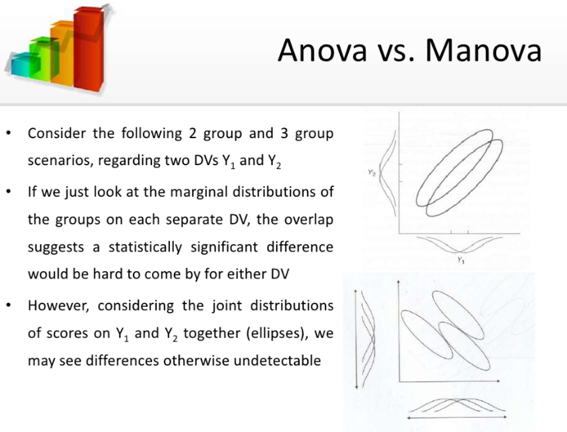

Slide 37
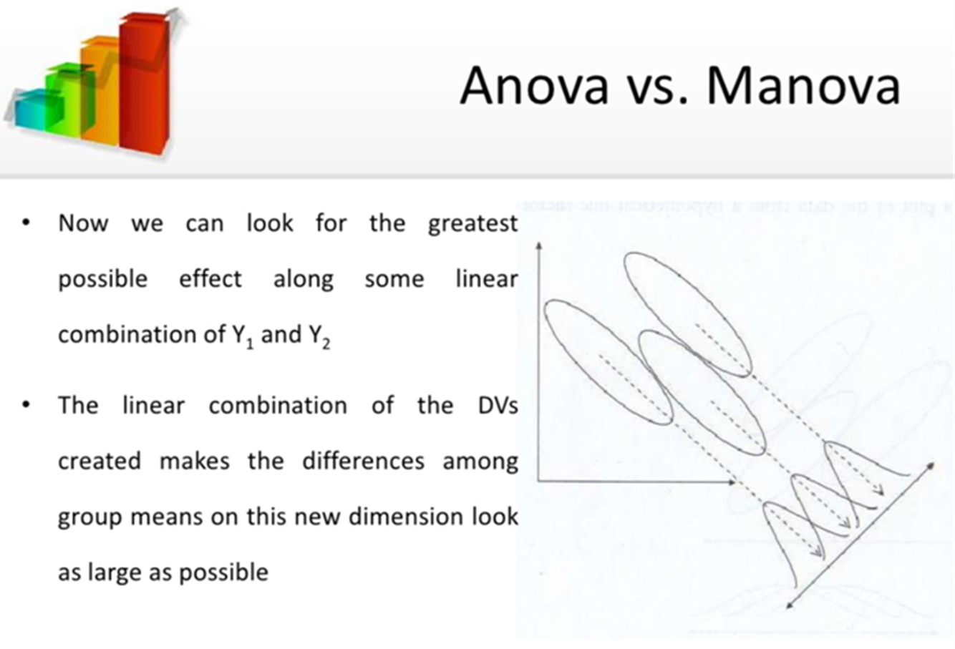

Slide 38
MANOVA versus ANOVA
In MANOVA, a new DV is created by making a linear combination of the individual DVs that maximizes the difference between groups¹
MANOVA requires one or more categorical independent variables² and two or more quantitative dependent variables
The questions are mostly the same as ANOVA, but on the linearly combined DVs
By measuring multiple DVs you increase your chances for finding a group difference - multiple measures usually do not “cost” a great deal more and you are more likely to find a difference on the combination than on each individually
MANOVA can reduce both Type 1 and Type 2 error rates³
Type 1) Using multiple ANOVAs inflates type 1 error rates – MANOVA reduces that
Type 2) Under certain conditions MANOVA may find differences that do not show up under ANOVA⁴
If there are any significant main effects or interactions, on which individual DV is there the most variation “caused” by the levels of the IV?
You can follow a significant MANOVA with individual ANOVAs to see the effects of the IVs on the individual DVs
Notes:
As always, we can create categorical variables by coding existing numerical variables more or less at will. A ‘one-factor’ MANOVA has one IV; a ‘two-way’ MANOVA has two IVs, and so on.
A Type 1 error is a ‘false positive’: the rejection of a true null hypothesis (that is, finding a “difference that makes a difference” where there really is none). A Type 2 error is a ‘false negative’: the non-rejection of a false null hypothesis (that is, not finding a “difference that makes a difference” where there is one) – in simpler language, a Type 1 error is where we find something that isn’t really there, and Type 2 is where we miss something that really is there.
We’ll see an example of this later in this lesson.

Slide 39
Assumptions of MANOVA
The interpretation of MANOVA results are always taken in the context of the research design – fancy statistical methods do not make up for poor design¹
For every DV, each group’s distribution is approximately normal² Can handle some non-normality, but not severe outliers
Check this by looking at histograms and/or normal quantile plots, calculate skewness/kurtosis, or use assumptions¹
Standard deviations of each group are approximately equal
Rule of thumb: The ratio of greatest group SD to the least SD must be less than 2:1
Notes:
For example, the use of IVs can change the interpretation of other IVs, so choice of IVs to include needs to be thought about carefully. Sound familiar?
With very small data sets, there really isn’t a really good way to check normality from data. But physical measurements of related phenomena (e.g. people’s healing time, or the prices of similar goods or services, or the fuel consumptions of similar vehicles) tend to be normally distributed, so we can make that assumption. Smaller data sets are less suitable for MANOVA than for ANOVA, for reasons we’ll discuss later.

Slide 40
MANOVA Theoretical Considerations (1 of 2)
Choice of DVs also needs to be carefully considered
Highly correlated DVs severely weaken the power of the analysis
The more complex the MANOVA model, the more limited the results are to the population studied; very difficult to ‘infer’¹
Missing data needs to be handled in the usual ways
We need significantly more cases than DVs in every cell of the design²
Can become difficult when the design becomes complex
If there are more DVs than cases in any cell the cell will become singular and cannot be inverted^{2a}
If there are only a few cases more than DVs, the assumption of equality of covariance matrices^{2a} is likely to be rejected
Notes:
This is saying that we cannot necessarily assume the results of a MANOVA analysis on a sample can be generalized to a population. This is related to another topic we’ll discuss later in the course, ‘overfitting’.
Let’s call it twice as many cases than DVs in each cell, for now. This is why small data sets are less suitable for MANOVA than for ANOVA. We’ll see what that means later.

Slide 41
MANOVA Theoretical Considerations (2 of 2)
Multivariate normality: the means of the various DVs in each cell and all linear combinations of them are normally distributed
In univariate tests, robustness against violation of the assumption is assured when the degrees of freedom for error is 20 or more and equal samples – if the least cell value is at least 20, then the test is robust to violations of multivariate normality even when there is unequal n.
If you have lesser values and/or unbalanced designs, the assumption is assessed on the basis of researcher judgment
Univariate and multivariate outliers need to be assessed in every cell of the design
MANOVA assume linear relationships between all DVs, all Control Variables (CVs)¹ and all DV/CV pairs
Notes:
As we have seen earlier in the course, a CV is a variable that is held constant in a given study.

Slide 42
Why Should You Do a MANOVA?
You do a MANOVA instead of a series of one-at-a-time ANOVAs for two reasons:
Reduce the experiment-wise level of Type 1 error
For example, if we do eight F tests, each at α=0.05, the experiment-wise probability of a Type 1 error (false positive – rejecting the null hypothesis when it is true) is 40%!
Reduce the likelihood of Type 2 error from multivariate inter-correlations
Individual ANOVAs may not produce a significant main effect on each DV, but in combination they might – independent variables may be more meaningful taken together than considered separately, which would be a type 2 error (false negative – accepting the null hypothesis when it is false)
MANOVA takes into account the intercorrelations among the DVs

Slide 43
Call Centre Example One-way ANOVA
A call center manager wants to know if there is a significant difference in average handle times amongst three different call operators
Independent Variable: Call Operator
Dependent Variable: Average Handle Time
Null Hypothesis (H₀): μ₁ = μ₂ = μ₃

Slide 44
Call Centre Example One-way ANOVA Data
Call handle time (seconds)
MS_{between} = SS_{between} / (c-1)
= 1.9 / (3-1)
= 0.95
MS_{within} = SS_{within} / (n-c)
= 22.5 / (30-3)
= 0.83
F = MS_{between} / MS_{within}
= 0.95 / 0.83
= 1.14
SS_{within} = 22.5 SS_{between} = 1.9

Slide 45
Call Centre Example One-way ANOVA Data
To reject the null hypothesis, we need F > F_{U} at some chosen confidence level
We choose α=0.05, then look in an F table¹
For α=0.05, F_{(2,27)} = 3.35
And from our data, F = 1.14
Since F < F_{U}, we cannot reject the null hypothesis
From the data given, we cannot conclude that any operator’s mean call handle time is significantly different from any other’s
Notes:
In this case, we used https://web.ma.utexas.edu/users/davis/375/popecol/tables/f005.html

Slide 46
Call Centre Example MANOVA
A call center manager wants to know if the operator or method of answering calls makes a difference on average handle time, wait time and customer satisfaction
Independent Variables: Call Operator, Method of Answering
Dependent Variables: Average Handle Time, Wait Time, Customer Satisfaction¹
Null Hypothesis (H₀): μ₁ = μ₂ = μ₃ , for all possible linear combinations of DVs for either IV or their combination
Notes:
Be careful here! Customer satisfaction is certainly an ordinal variable; it’s a stretch to think of it as interval or ratio.

Slide 47
Call Centre Example MANOVA Data
Handle Time | Wait Time | Customer Sat. | Operator | Method of Answering
76.5 | 39.5 | 4.4 | 1 | 1
76.2 | 39.9 | 6.4 | 1 | 1
75.8 | 39.6 | 3.0 | 1 | 1
76.5 | 39.6 | 4.1 | 1 | 1
76.5 | 39.2 | 0.8 | 1 | 1
76.9 | 39.1 | 5.7 | 1 | 2
77.2 | 40.0 | 2.0 | 1 | 2
76.9 | 39.9 | 3.9 | 1 | 2
76.1 | 39.5 | 1.9 | 1 | 2
76.3 | 39.4 | 5.7 | 1 | 2
76.7 | 39.1 | 2.8 | 2 | 1
76.6 | 39.3 | 4.1 | 2 | 1
77.2 | 38.3 | 3.8 | 2 | 1
77.1 | 38.4 | 1.6 | 2 | 1
76.8 | 38.5 | 3.4 | 2 | 1
77.1 | 39.2 | 8.4 | 2 | 2
77.0 | 38.8 | 5.2 | 2 | 2
77.2 | 39.7 | 6.9 | 2 | 2
77.5 | 40.1 | 2.7 | 2 | 2
77.6 | 39.2 | 1.9 | 2 | 2
Notes:
Be careful here! Customer satisfaction is certainly an ordinal variable, but it’s a stretch to think of it as interval or continuous.

Slide 48
Call Centre Example MANOVA in SPSS: F-test
Entering the data into SPSS, we get the following result:
We can see that the calculated values for p (Sig) are less than 0.05 for the two IVs (but not for the combination) – we can say that both Operator and Method of Answering have an effect on the combination of the three DVs

Slide 49
Call Centre Example MANOVA in SPSS: residual variance
The Residual SSCP Matrix shows the degree of correlation among the dependent variables
Because the degree of overall correlation among the DVs is weak¹, one might achieve more accurate individual results with three univariate ANOVAs on these responses
Notes:
The strongest relationship is between Handle Time and Customer Sat: r = -0.29, so r² = 0.084.

Slide 50
Call Centre Example MANOVA in SPSS: result
The call center manager learns that the particular operator that a customer gets when calling, and the method that the operator uses to answer the call, both have a significant impact on the group of dependent variables Average Handle Time, Wait Time and Customer Satisfaction
However, we also learned that the dependent variables are not as correlated as we thought
With uncorrelated variables, we avoid the danger of a Type I error when running multiple ANOVA tests
If we run univariate separate ANOVA tests on each DV, we may better understand the impact that the independent variables has on each of the dependent variables alone
If those tests do not show an effect, then the MANOVA has uncovered a relationship that was hidden by a Type II error in the separate ANOVA tests

Slide 51
Conclusion: ANOVA vs MANOVA
ANOVA uses one or more categorical independent variables as predictors, but only one quantitative dependent variable; in MANOVA there is more than one dependent variable
In ANOVA, we use the univariate F-test to determine significance of a factor; in MANOVA, we use a multivariate F-test called Wilk’s Lambda
The F-value in ANOVA is based on a comparison of the factor variance to the error variance; in MANOVA, we compare the factor variance-covariance matrix to the error variance-covariance matrix to obtain Wilks’ lambda – the covariance here is included because we must take the correlation between the DVs into account when performing the significance test

Slide 52

Before our break – MANOVA in Excel
MS Excel does not include a native MANOVA tool, but we want to use it – you must download and install the Real Statistics Resource Pack¹
At https://www.real-statistics.com/, click ‘Free Download’
Follow the instructions from the website to install in Windows or MacOS
Before you install the Resource Pack, you must ensure the Solver Add-in is enabled in MS-Excel²
Move the downloaded Excel macro file to the recommended location³
Enable the Xrealstats Add-in⁴
Take a look! Click on Add-ins in the Excel menu bar⁵ and click on Real Statistics⁶
MANOVA (along with some other multivariate data analysis tools we’ll look at later in the term) is in the ‘Multivar’ tab
Notes:
This comes from Real Statistics Using Excel, from Charles Zaointz, PhD. The resource pack is available free, with contributions encouraged if you’re using it extensively. The resource pack includes other data analysis tools for Excel too – if you want to explore them, the Real Statistics website also offers some exercises.
You will use the same procedure to do this as we used for ensuring the Analysis ToolPak was enabled back in week 2.
Be careful about this! If you put the file in the wrong location, it will be harder to move later on.
You should be familiar with this procedure by now!
Add-ins sometimes disappears! You can often get it to reappear by disabling the Real Satatistics add-in then re-enabling it. You may also be able to bring up the took pack by pressing ctrl-M on your keyboard.
You will see all sorts of interesting statistical tools here, which you are welcome to explore on your own time for use in other courses and/or in your future work. But for now the only thing we will use this for is MANOVA – we’ll stick with native Excel tools for everything else.

Slide 53
Next up: Exercise 6ab
We’re not done yet…
Be back in your seats, phasers on stun and ready to go in ~10m

Slide 54
Exercise #6ab – Hypothesis Testing in Excel, part 2 – ANOVA, MANOVA
Let’s have a look at how we can do this in Excel…

Slide 55
Exercise 6a – ANOVA
To run an ANOVA, you need at least two columns¹: one or more independent categorical variables² and one dependent numerical variable
Sometimes this exists in your raw data, sometimes it has to be created with Pivot Tables – we’ll create a new variable ‘Shift’³ then pivot it against Queue Seconds⁴
ANOVA can work from a pivot table – go to Data / Data Analysis and choose ‘Anova: Single Factor’⁵
In the dialog box that comes up, enter your input range (include row labels but not Job Number), choose ‘Columns’ for ‘Grouped By:’, check ‘Labels in First Row’ and leave the default Alpha’⁶
To put your results on the same worksheet, select ‘Output Range:’ and then specify a location that has lots of empty cells to the right and below⁷
Notes:
You probably want category labels for the columns.
MS-Excel can only handle up to 2 IVs. In this case, our one categorical variable is spread across three columns.
This independent categorical variable three possible values – that it, it is polytomous. We can’t use a t-test in this case, so we need a new kind of test.
This pivot table has Job Number in ‘Rows’, Shift in ‘Columns’, and Sum of Queue Seconds in ‘Values’ – since the Job Number is unique within this one day, that’s enough for us! We’re excluding those pesky outliers again.
This is for ANOVA with one independent variable (and the IVs in ANOVA are always categorical); you can also do it for two IVs.
Remember that alpha is the selected equivalent of a calculated p-value – it is a value the analyst chooses as the acceptable probability that the results achieved are due to chance (sampling error).
ANOVA output is at least seven columns wide and 14 rows deep.

Slide 56
Exercise 6b – MANOVA
Next up: Evaluations & Assessments
To run a MANOVA, you need at three or more columns¹: one or more independent categorical variables² and more than one dependent numerical variables³
Sometimes this exists in your raw data, sometimes it has to be created with Pivot Tables – we’ll add CPU Seconds to our ANOVA table⁴
Real Statistics MANOVA can work from a pivot table – go to Add-ins, and under ‘Multivar’, choose ‘Manova: One Factor’⁵
Pick your input range to cover only the column labels and all values, but not the Job Number; use ‘Regular’ analysis⁶, choose all options except ‘Contrast’, and leave Alpha at 0.05⁷
To put your results on the same worksheet, select ‘Output Range:’ and then specify a location that has lots of empty cells to the right and below⁸
Notes:
You need category labels for the horizontal axis, and numerical values for the primary (left) vertical axis.
The Real Statistics add-in for MS-Excel can only handle up to 2 IVs. In this case, our one categorical variable is in a single column.
If there was only one numerical DV, we would just use ANOVA.
Now there are two numerical DVs plus one polytomous IV, so ANOVA won’t work for us any more. NOTE that this won’t work if there are blanks in the pivot table area. We’re still excluding those pesky outliers.
This is for MANOVA with one independent variable; you can do it for two as well, with ‘Two Factor MANOVA’.
If your data include before-and-after values or otherwise correlated data, you may need to use ‘Repeated Values’ analysis.
Remember that alpha is the equivalent of a p-value – it is a value the analyst chooses as the acceptable probability that the results achieved are due to chance (sampling error).
MANOVA output is dozens of columns wide and rows deep.

Slide 57
Evaluations & Assessments
This is where the work is. You have to actually do stuff, and…
Oh wait, you have to study your reading materials too!

Slide 58
New this week! Mid-term exam
THIS IS A CLOSED-BOOK, INDIVIDUAL TEST. You may not collaborate in any way. You may not use any materials other than your mind, your keyboard and your pointing device, and you may not have any other applications (except a calculator) open on your computer
You should write your exam in a quiet place with a strong, stable internet signal; You should have your charger available, and your laptop software fully updated to reduce the chance of unexpected restarts
Please save your answers from time to time, watching to ensure that the process is working properly; if it's not, or if you have any other issue, please take screenshots of your progress and reconnect or restart as needed. You should be able to continue your exam, but any time spent will be lost.
Your mid-term exam is
one attempt in Week 7, open from start of day Tuesday until end of day Thursday.¹ There is no class in Week 7.²
Before you write… make sure your computer is up-to-date, your charger is connected, and you are in a quiet place with a strong, stable internet connection.
The test is in Blackboard; it covers Lessons 1-5 and Exercises 2-5 and is worth 15% of the course; it will be open from start of day Tuesday to end of day Thursday in Week 7^{1,2} – you will each receive 50 questions (50 marks) to answer in 1.5 hours (90 min)
You get one try at the exam. Once your time is up, all answers will be automatically saved and the test will auto-submit
Notes:
That’s Tue Jun 20, 00:00, to Thu Jun 22, 23:59 Eastern Daylight Time (EDT=UTC-4h).
There will be no class in Week 7. If you want to meet with your professor, please reach out to arrange a mutually convenient time.

Slide 59
New this week! Dataset Exploration part 3
Through the four parts of this project, keep in mind these ten steps to basic data analysis. In DE pt 3, you improve steps I through V and focus on step VI – don’t jump ahead, it’s important that you take this in order!
Define your research question(s)
Define your ideal dataset
Define or discover what data could be available
Obtain the data
Perform univariate data analysis, including examination, visualization, and preliminary cleaning and coding
Develop hypotheses and perform appropriate bi- and multi-variate statistical analysis
Visualize and interpret results (including tables, charts and diagrams)
Verify / challenge results
Communicate results
Create reproducible instructions for others to recreate results
We have not yet studied parts of some of these steps. Give it time!
This is part 3 of four parts of an individual cumulative project
In DE pt3 you will update & improve your previous work according to grading feedback and your own continued work, develop and test at least five hypotheses of a variety of types, describe the results and provide visualizations, reconsider your FINER questions, and continue to track your analysis – DON’T JUMP AHEAD!¹
There are two places for you to submit materials in Blackboard: ‘DE Turnitin’ for you to check your discussion papers for citations, references, etc. and ‘DE Part 3’ for your project submissions – make sure you get it right, to avoid penalties!²
Let’s work from the description³, which you’ll find in the Assignments & Tests folder in Blackboard for this course – and make sure you submit your own work, with citations for anything you’ve ‘borrowed’⁴
Part 3 is due end of day Sunday after Week 9⁵; Part 4 will be made available in Week 9
Notes:
Some students in past terms have ‘jumped ahead’ to applying statistical techniques we have not studied yet. Don’t! Many students won’t yet understand those techniques, and we really need to learn to use the techniques we’ve already learned.
Check the rubric for details. This is also the way things work in the enterprise world – for example, if you submit your response to a Request for Proposals or a Request For Quotes (RFP or RFQ, when an enterprise seeks proposals or quotes from vendors for work that needs to be done) late or to the wrong place, it may be penalized, discounted or entirely ignored.
This link won’t work on your computers because it depends on local file structure. You can view it in Blackboard.
If you quote or borrow material without citation, you may be subject to penalties up to and including Academic Misconduct. This includes any chart, graph, table or other representation of data in your submitted document unless it is also included in your submitted spreadsheet.
That’s Sun Mar 19, 23:59 Eastern Daylight Time (EDT=UTC-4h), after the time change.

Slide 60
New assignments Week 6
NOTE that all assignment and due dates are covered in the Alignment Document in Course Materials
Lesson 6, Exercise 6 – but not for the Mid-term exam!
New Evaluations & Assessments – ordered by due date
Mid-term Exam – open start of day Tuesday through end of day Thursday in Week 7¹ – NOTE there is no class in week 7 – we’ll meet again after Study Week (Jun 26-30)
Exercise 6 – ANOVA, MANOVA – complete before week 8²
Dataset Exploration part 3 – due end of day Sunday after week 9³
Notes:
That’s Tue Jun 20, 00:00, to Thu Jun 22, 23:59 Eastern Daylight Time (EDT=UTC-4h).
Complete it by Sun Jul 2, 23:59 EDT (UTC-4h), before our next class in week 8, after Study Week. Exercises are not submitted or graded – you do them to assist you in learning the course material and building your skills.
That’s Sun Jul 16, 23:59 EDT (UTC-4h).

Slide 61
Lesson Quizzes
Five quizzes to help you study the course material – Lesson 3-4 Quiz closed; Lesson 5 Quiz still open
9 lessons in the course – quizzes cover L1-2, L3-4, L5 (all before mid-term), then L6-7, L8-9 – worth a total of 18% of course (2% per lesson covered)
Each available with weekly learning materials of last week covered, due end of day Sunday the following week – the Lesson 5 Quiz is still available, due end of day Sunday after week 6¹ so you can see results before your Mid-term Exam
Quiz questions are similar to exam questions²
Each student can try the quiz two times (before due date) – try once, see what you need to study, then try again - you get the better of the two marks you achieve, so there’s no down side to taking it twice and you’ll see more questions that way!
Quizzes close at due date and will not be available for late submission
Notes:
That’s Sun Jun 18, 23:59 Eastern Daylight Time (EDT=UTC-4h).
It’s the same material being tested, of course… but questions may be differently organized (e.g. fill-in-the-blank instead of multiple choice, or multiple choice instead of true/false) and worded.

Slide 62
Dataset Exploration part 2
Through the four parts of this project, keep in mind these ten steps to basic data analysis. In DE pt 2, you improve steps I through IV and focus on step V – don’t jump ahead, it’s important that you take this in order!
Define your research question(s)
Define your ideal dataset
Define or discover what data could be available
Obtain the data
Perform univariate data analysis, including examination, visualization, and preliminary cleaning and coding
Develop hypotheses and perform appropriate bi- and multi-variate statistical analysis
Visualize and interpret results (including tables, charts and diagrams)
Verify / challenge results
Communicate results
Create reproducible instructions for others to recreate results
We have not yet studied some of these steps. Give it time!
This is part 2 of four parts of an individual cumulative project
In DE pt2 you will update & improve your previous work according to grading feedback and your own continued work, perform univariate analysis on at least eight variables of a variety of types, check numerical variables for outliers, clean your dataset with justifications, code at least one variable, provide visualizations, reconsider your FINER questions, and continue to track your analysis – DON’T JUMP AHEAD!¹
There are two places for you to submit materials in Blackboard: ‘DE Turnitin’ for you check your discussion papers for citations, references, etc. and ‘DE Part 1’ for your project submissions – make sure you get it right, to avoid penalties!²
Let’s work from the description³, which you’ll find in the Assignments & Tests folder in Blackboard for this course – and make sure you submit your own work, with citations for anything you’ve ‘borrowed’⁴
Part 2 is due end of day Sunday after Week 7⁵; Part 3 will be made available in Week 6
Notes:
Some students in past terms have ‘jumped ahead’ to applying statistical techniques to try to answer their questions. Don’t! Many students won’t yet understand those techniques, as we won’t study them until later in the term… and perhaps more importantly, we really need to learn to understand our data before we start comparing variables.
Check the rubric for details. This is also the way things work in the enterprise world – for example, if you submit your response to a Request for Proposals or a Request For Quotes (RFP or RFQ, when an enterprise seeks proposals or quotes from vendors for work that needs to be done) late or to the wrong place, it may be penalized, discounted or entirely ignored.
This link won’t work on your computers because it depends on local file structure. You can view it in Blackboard.
If you quote or borrow material without citation, you may be subject to penalties up to and including Academic Misconduct. This includes any chart, graph, table or other representation of data in your submitted document unless it is also included in your submitted spreadsheet.
That’s Sun Jun 25, 23:59 Eastern Daylight Time (EDT=UTC-4h).

Slide 63
Summary of assignments Week 6
Lessons 1-6, Exercises 2-6 – but remember, it’s just L1-5, X2-5 for the Mid-term exam!
Outstanding Evaluations & Assessments – ordered by due date
Lesson 5 Quiz – due end of day Sunday after week 6¹
Mid-term Exam – open start of day Tuesday through end of day Thursday in Week 7² – NOTE there is no class in week 7 – we’ll meet again after Study Week
Dataset Exploration part 2 – due end of day Sunday after week 7³
Update your work, perform univariate descriptives, check for outliers, clean, categorize & provide visualizations
Submission penalties – missing Turnitin report 5%; late submission 10% per week
Exercise 6 – ANOVA, MANOVA – complete before week 8⁴
Dataset Exploration part 3 – due end of day Sunday after week 9⁵
Update your work, develop & test hypotheses and describe results with visualizations, continue tracking
Penalty up to 5% for missing Turnitin report; LATE PENALTY is 10% per week
Next up: Work Time / Office Hour
Notes:
That’s Sun Jun 18, 23:59 Eastern Daylight Time (EDT=UTC-4h).
That’s Tue Jun 20, 00:00, to Thu Jun 22, 23:59 EDT (UTC-4h).
That’s Sun Jun 25, 23:59 EDT (UTC-4h).
Complete it by Sun Jul 2, 23:59 EDT (UTC-4h), before our next class in week 8, after Study Week. Exercises are not submitted or graded – you do them to assist you in learning the course material and building your skills.
That’s Sun Jul 16, 23:59 EDT (UTC-4h).

Slide 64
Work Time & Office Hour
Students may stay online to review material or work on assignments, or log off whenever they please
Your professor will be happy to publicly handle class or assignment questions or concerns¹
Individuals who have private concerns they want to discuss should make separate arrangements.
Dataset Exploration pt2
Work on cleaning, coding & univariates; update & improve your work from DE pt1
Dataset Exploration pt3
Work on building & applying hypothesis tests; update & improve your work from DE pts1-2
Notes:
Individuals who have personal questions, comments or concerns they want to discuss should find another time to meet by arrangement with their professor.

Slide 65
Questions? If not… Class Adjourned
Have a great week, and good luck with all of your mid-term tests & assignments!
I will stay online until the end of class time or until no-one else is online¹.
See you next week, phasers on stun² and ready to go by class start time.
Notes:
Except as discussed – for example, if people are online but not asking questions, I may ask if they need anything, then close the session if no-one says or writes anything.
Or mics on mute, but at least one of us is old enough to remember the zappy 1978 pop song “Phasers on Stun”, by FM. Whichever.

